Slide 1
Stock Market Prediction
An overview of techniques, models, and applications
Submitted to - Dr Abhishek Singh
Group members

Slide 2
What is stock market?
Understanding the stock market
Definition - The stock market is a platform where shares of publicly held companies are bought and sold.
Components :
STOCKS - Represents ownership in a company and a claim on part of its assets and earnings.
EXCHANGES - Physical or virtual places where stocks are traded (e.g., NYSE, NASDAQ).
Purpose: Facilitates the exchange of securities, provides liquidity, and helps companies raise capital.

Slide 3
Nifty 50?
The "Nifty50" refers to a group of fifty large-cap stocks actively traded on the National Stock Exchange of India (NSE). These stocks are selected based on various criteria such as market capitalization, liquidity, trading volume, and sector representation. The Nifty Fifty index serves as a benchmark for the Indian stock market and is widely followed by investors, traders, and analysts.
The Nifty 50 index includes companies from various sectors such as finance, information technology, healthcare, consumer goods, and energy. Some of the prominent companies in the Nifty 50 index include Reliance Industries, Infosys, HDFC Bank, Tata Consultancy Services, and Hindustan Unilever.
Investors often use the Nifty 50 index as a reference point to assess the performance of the Indian stock market as a whole or to compare the performance of individual stocks against the broader market index. Additionally, the Nifty Fifty index serves as the basis for various financial products such as index funds, exchange-traded funds (ETFs), and derivatives contracts.

Slide 4
Stock Market Prediction through Machine Learning
Definition: Stock market prediction involves forecasting future stock prices or trends based on historical data and other relevant information.
Objective: To leverage machine learning algorithms to identify patterns and make informed predictions about stock prices.
Challenges :
Volatility: Stock markets are highly volatile and influenced by numerous unpredictable factors.
Non-Linearity: Stock price movements are non-linear and complex.
Noise: Financial data contains a lot of noise which can obscure true patterns.

Slide 5
Machine learning approaches
Supervised Learning: Algorithms learn from historical data to predict future prices.
Time Series Analysis: Techniques like ARIMA, moving averages.
Deep Learning: Advanced models like LSTM (Long Short-Term Memory) which are effective for sequential data.
Data Preparation
Data Collection: Historical stock prices, trading volumes, financial indicators.
Feature Engineering: Creating relevant features such as moving averages, volatility indices.
Normalization: Scaling data to improve model performance.

Slide 6
LSTM
Purpose: LSTM is a type of recurrent neural network (RNN) designed to overcome the vanishing gradient problem in traditional RNNs, allowing them to learn long-term dependencies in sequential data.
Application: LSTM networks are widely used in various tasks involving sequential data, such as time series prediction, natural language processing, and speech recognition.
Architecture
Memory Cells: LSTM networks contain memory cells that store information over time, allowing them to retain long-term dependencies.
Gates: LSTM units have three gates:
Forget Gate: Determines what information to discard from the cell state.
Input Gate: Regulates the flow of new information into the cell state.
Output Gate: Controls the flow of information from the cell state to the output.

Slide 7
Working Principle
Forget Gate Operation: Determines which information from the previous cell state to forget.
Input Gate Operation: Decides which new information to store in the current cell state.
Update Cell State: Combines the forget and input gate outputs to update the cell state.
Output Gate Operation: Determines the information to pass to the output based on the updated cell state.
Advantages
Long-Term Dependencies: LSTM networks excel at capturing long-term dependencies in sequential data.
Gradient Stability: Address the vanishing gradient problem, making them suitable for training on long sequences.
Flexibility: Can be used for a wide range of sequential data tasks and integrated into larger neural network architectures.
Limitations
Complexity: LSTM networks have more parameters and computational complexity compared to traditional RNNs.
Training Time: Training LSTM networks can be computationally intensive and time-consuming, especially with large datasets.
Overfitting: Like other neural networks, LSTMs are prone to overfitting if not properly regularized or validated.

Slide 8
WHY LSTM ?
Why LSTM?: Capable of learning long-term dependencies in sequential data, making it suitable for stock price prediction.
Architecture: Consists of multiple layers including LSTM and Dense layers.
Training: The model is trained on sequences of stock

Slide 9
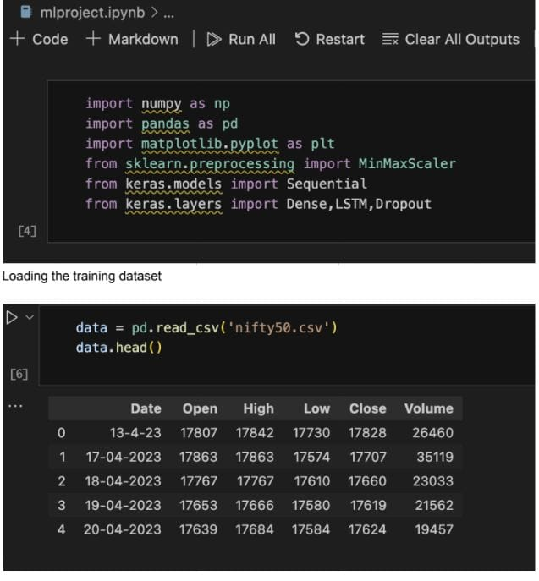
Importing the modules and libraries-
We’ve taken nifty fifty index from 13th April 2023 - 13th April 2024

Slide 10
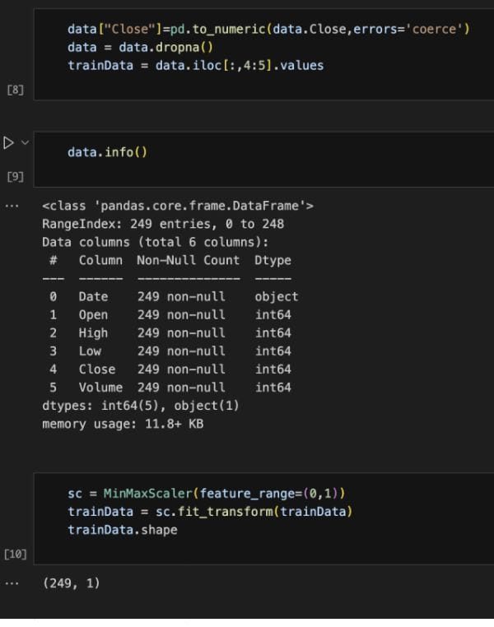
Normalising the datasets and training the data structures -

Slide 11
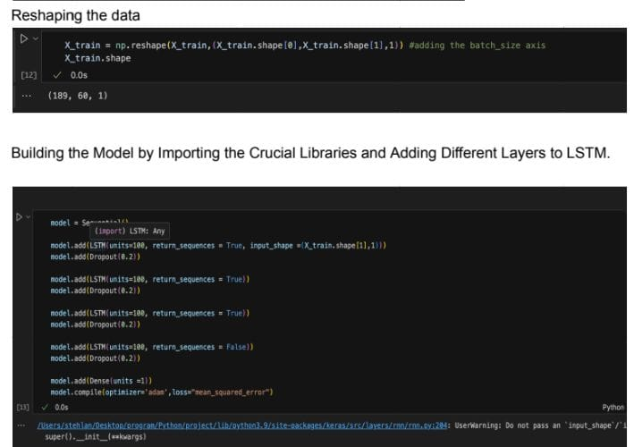
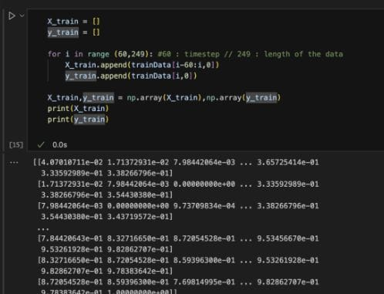
Training the dataset

Slide 12
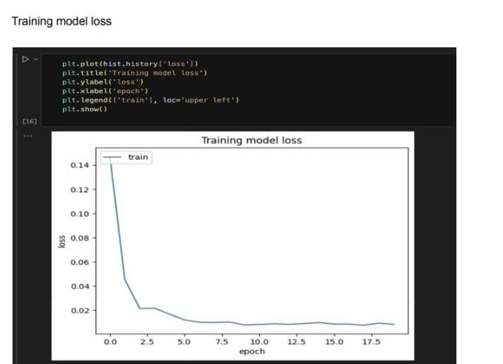
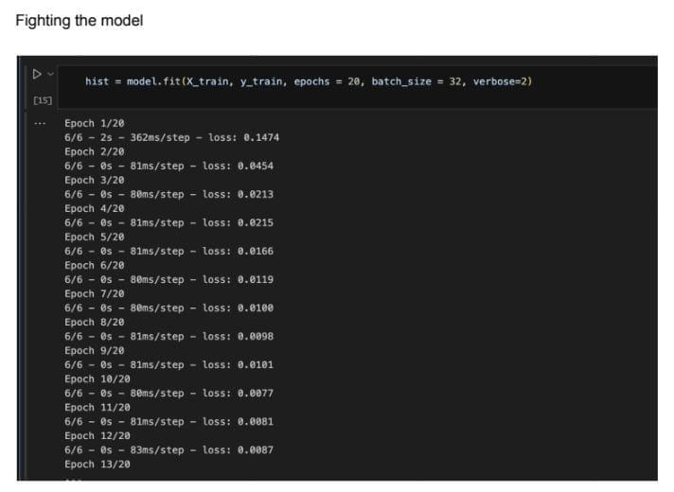

Slide 13
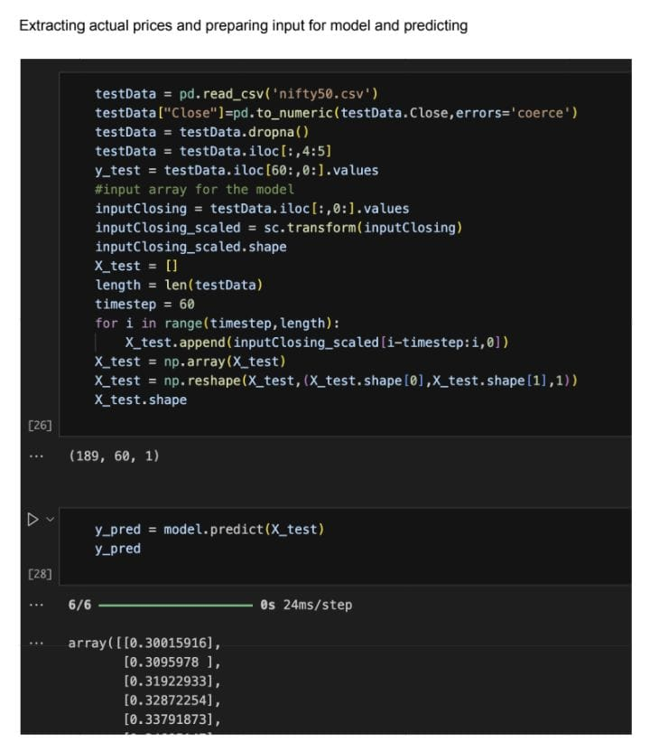

Slide 14
